Slide 1



Admin Training
Project Execution and Tracking

Slide 2
Learning Objectives Project Execution & Tracking
Teach
(Slides)
Show
(Demo)
Do
(Exercises)
Review
(Q&A)
Project Execution & Tracking Overview
Milestones
Tied to Workflow States
Warning Days Before Target
Project Management
Add / Edit Project Items
Project Item Types
Baselines

Slide 3
Project Execution & Tracking Overview
Autodesk Fusion Lifecycle provides project execution and tracking through Project Management, Milestone, and Tasks functionalities. Highlights of these methods include:
Tracking of Tasks, Workflow States, and/or Standalone Items
Start and Target Dates in a Single, High-Level Timeline
Pre-Requisite Capability
Total Overview of a Project with Rolled-Up Tasks
Color-coded Visibility to Project Status
Progress Reflected as it Happens
Gantt Chart Format to Show Visual Status
Ability to Create Multiple Baselines of Project

Slide 4

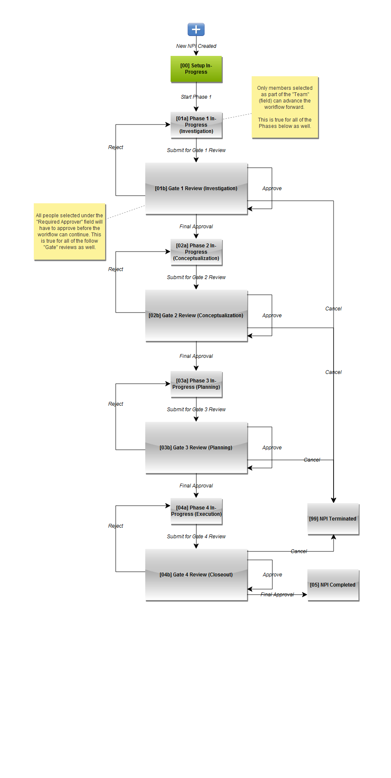
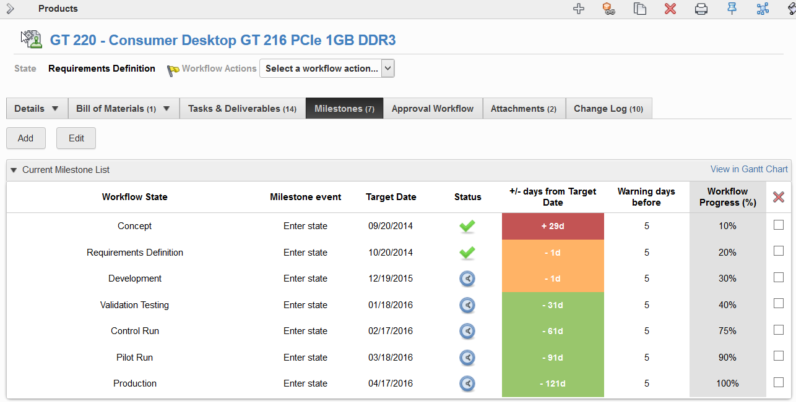
Milestones
With Milestone capability you can assign target dates to workflow states in order to set a high-level timeline visible to all. It is easy to track the progress of the workflow's key events to completion. Pre-set warning periods give color-coded visibility both in the Milestones tab and as a flag on the item wherever the item's current state appears.

Slide 5
Milestones
Track entry or exit of states on certain dates
Set a warning to flag upcoming targets
Outside of warning
Due date soon
Overdue
Indicate completion percentage within workflow

Slide 6

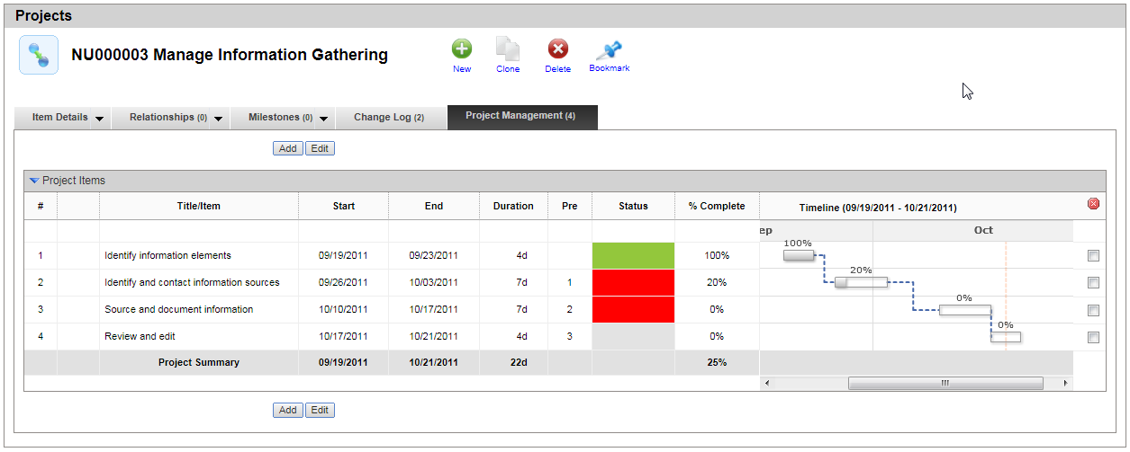
Project Management
Use the Project Management functionality to build your project plan and quickly see the progress of your project. The Project Management View displays tasks by target dates and status, and reflects progress as it happens. A Timeline is shown in Gantt Chart format to show the status of your project visually, while Prerequisites keep the project flow organized.

Slide 7
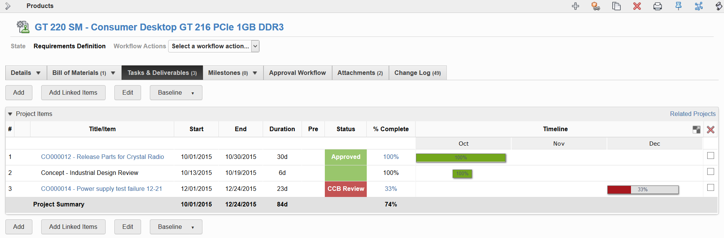
Project Management Tab
Add / Edit project items
Track with start and end dates and a roll up of % complete
Duration and status are always calculated for you

Slide 8
Project Item Types
Standalone
Linked Workflow Item
Linked Revision-Controlled Item
Linked Workflow Item with Milestones
Linked Master Project Item

Slide 9
Project Item Types
Standalone
Tracked manually: title, start & end dates, Pre and % completed.
Due date still ahead or 100% complete
Due date passed and not yet 100% complete

Slide 10
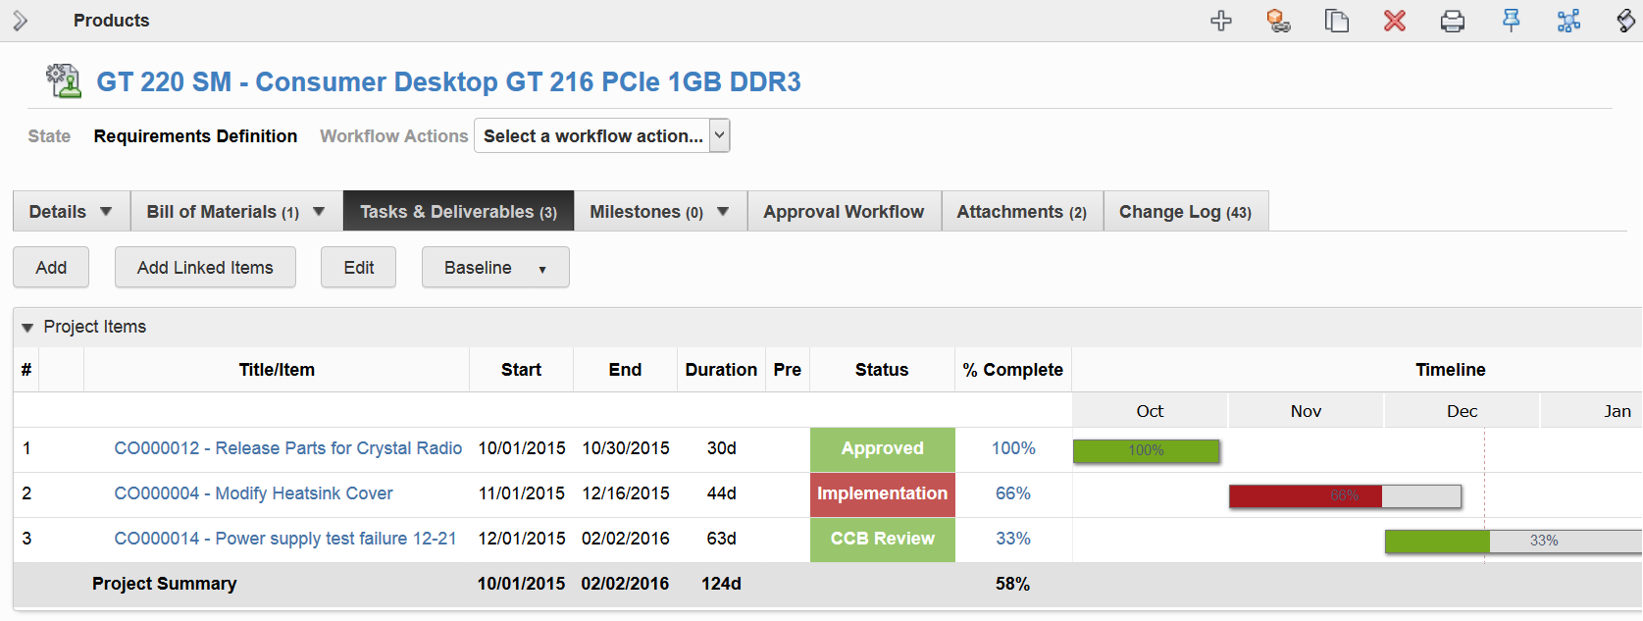
Project Item Types
Linked Workflow Item
Tracking shows the linked item, reflecting its status as it transitions through its workflow. Tracked manually: start & end dates, Pre and % completed.
Due date still ahead or 100% complete
Due date passed and not yet 100% complete

Slide 11
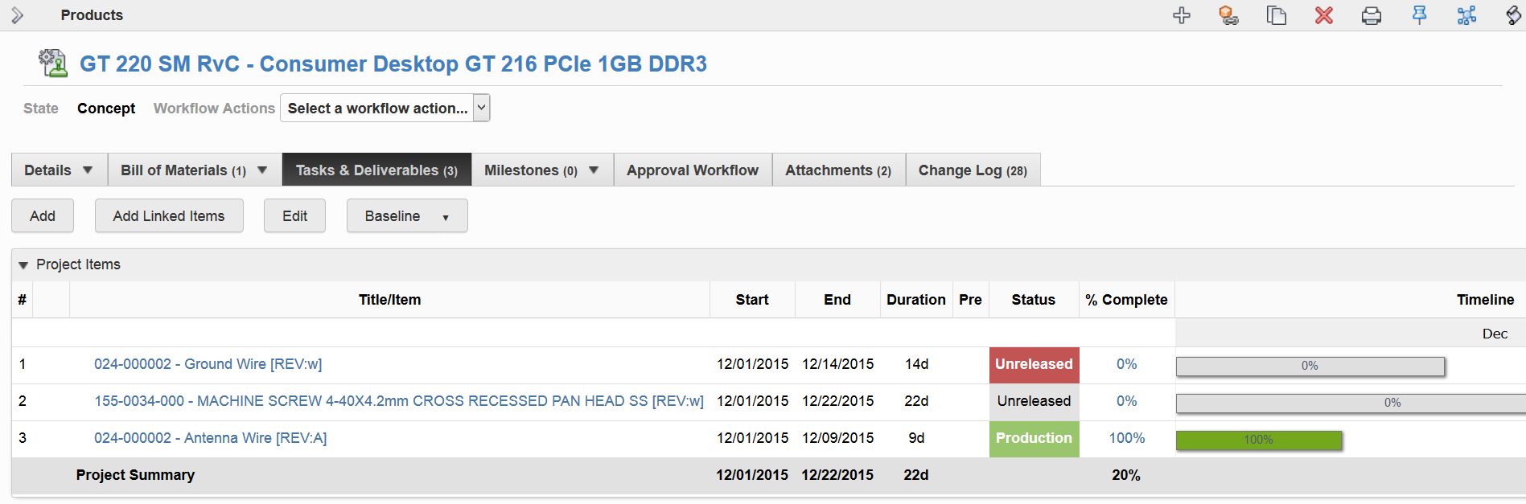
Project Item Types
Linked Revision-Controlled Item
Tracking shows the linked item, reflecting its lifecycle as it is transitioned through its lifecycle map. Tracked manually: start & end dates, Pre and % completed.
100% complete
Due date passed and not yet 100% complete
Due date still ahead

Slide 12
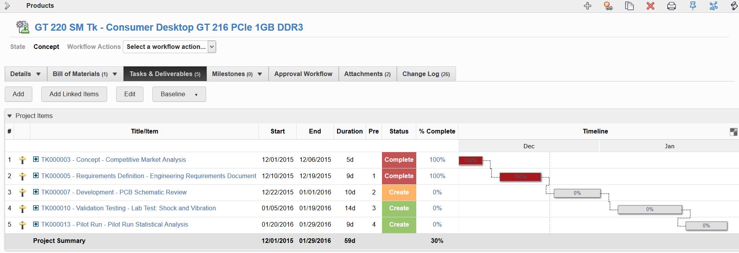
Project Item Types
Linked Workflow Item with Milestones
Tracking shows the linked workflow item, reflecting its milestone status as it transitions through its workflow. Filled from linked item’s milestones: start & end dates, % completed.
100% complete before milestone’s due date OR due date still ahead
100% complete within warning period OR due date is within warning period
100% complete after due date OR due date has passed

Slide 13
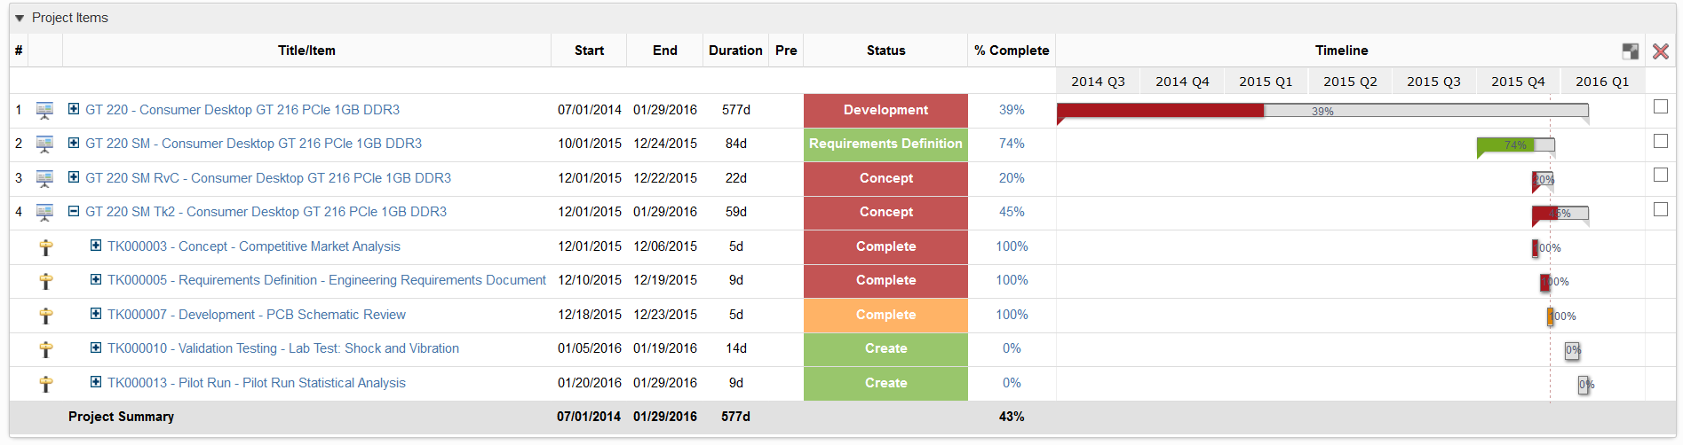
Project Item Types
Linked Master Project Item
Tracking shows the linked project item, reflecting its workflow status and its sub-item statuses. Reflects the progress and status of all project items as a whole. Filled from linked item: start & end dates, % completed.
100% complete before milestone’s due date OR due date still ahead
100% complete within warning period OR due date is within warning period
100% complete after due date OR due date has passed

Slide 14
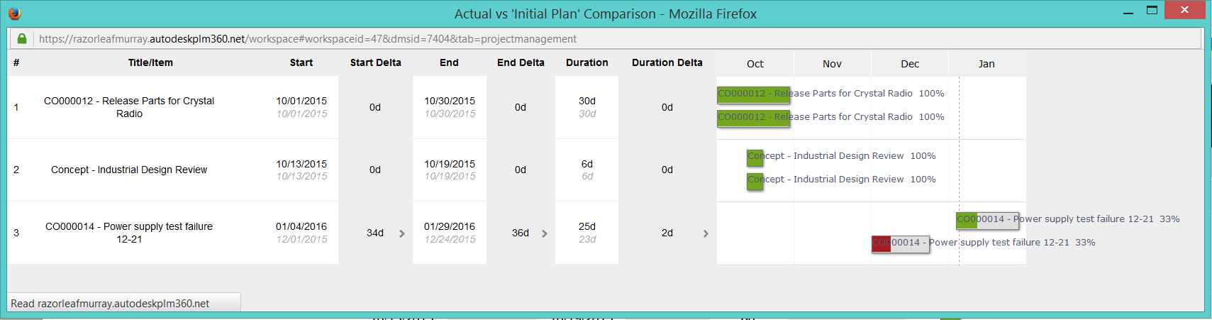
Project Management Baselines
Choose different created baselines to compare with actual
Deltas for Start, End, Duration
Includes visual

Slide 15
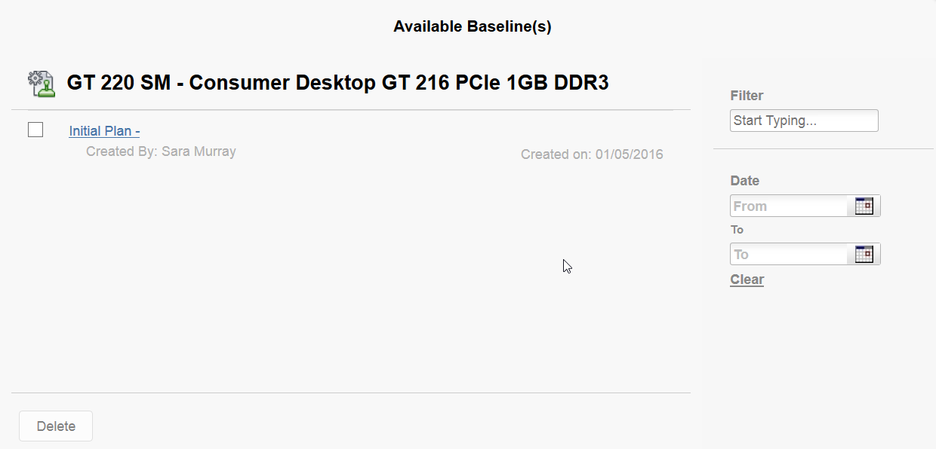
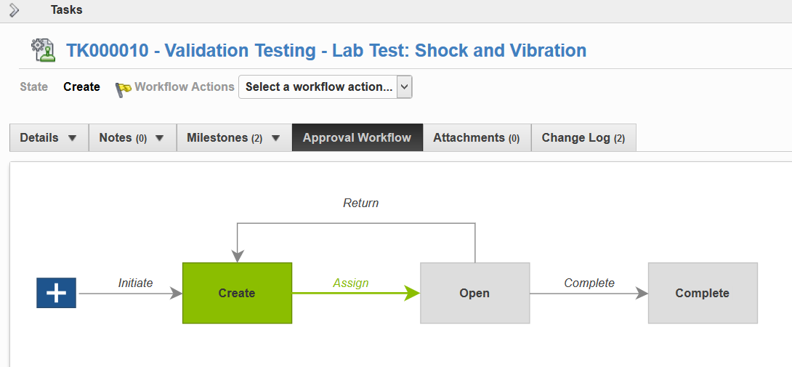
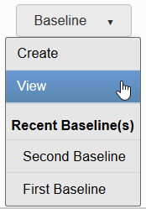
Teach
(Slides)
Show
(Demo)
Do
(Exercises)
Review
(Q&A)
Demo Topics Project Execution & Tracking
Overview
Milestones
Tasks with Workflow
Project Management
Standalone Items
Linked Items
Baselines

Slide 16
Exercises 1 - 3
Teach
(Slides)
Show
(Demo)
Do
(Exercises)
Review
(Q&A)

Slide 17
Review Project Execution & Tracking
Teach
(Slides)
Show
(Demo)
Do
(Exercises)
Review
(Q&A)
Project Execution & Tracking Overview
Milestones
Tied to Workflow States
Warning Days Before Target
Project Management
Add / Edit Project Items
Project Item Types
Baselines

